Slide 1
Mobile Application
Market
Coltt Thunstrom, Prasanna Rajendran, Jordan Boonstra, Henrik Kowalkowski, Shashank Singh, and Shawn Tangen

Slide 2
What Defines a Successful Mobile Application
Rankings
Success
Factors
Ratings Per Day
Overall Average
Rating
Notes:
https://netwallcraft.com/maps-of-us-outline-blue-png-clipart-state-map/maps-of-us-outline-blue-png-clipart-state-map-save-maps-us-outline-blue-of-maps-of-us-outline-blue-png-clipart-state-map-new-maps-of-maps-of-us-outline-blue-png-clipart-state-map/
https://commons.wikimedia.org/wiki/File:China-outline.svg
https://www.vpndate.com/change-google-play-store-country-region-download-free-apps/
https://developer.apple.com

Slide 3


Successful Apps Have Certain Attributes
Characteristics
Distribution/Platform
Games
In-App Ads
USA
Google Play Store
Free
In-App Purchases
Mobile
Notes:
https://netwallcraft.com/maps-of-us-outline-blue-png-clipart-state-map/maps-of-us-outline-blue-png-clipart-state-map-save-maps-us-outline-blue-of-maps-of-us-outline-blue-png-clipart-state-map-new-maps-of-maps-of-us-outline-blue-png-clipart-state-map/
https://commons.wikimedia.org/wiki/File:China-outline.svg
https://www.vpndate.com/change-google-play-store-country-region-download-free-apps/
https://developer.apple.com

Slide 4
Successful Apps Have Certain Characteristics
Characteristics
Distribution/Platform
Games
In-App Ads
USA
Google Play Store
Free
In-App Purchases
Mobile
Notes:
https://netwallcraft.com/maps-of-us-outline-blue-png-clipart-state-map/maps-of-us-outline-blue-png-clipart-state-map-save-maps-us-outline-blue-of-maps-of-us-outline-blue-png-clipart-state-map-new-maps-of-maps-of-us-outline-blue-png-clipart-state-map/
https://commons.wikimedia.org/wiki/File:China-outline.svg
https://www.vpndate.com/change-google-play-store-country-region-download-free-apps/
https://developer.apple.com

Slide 5
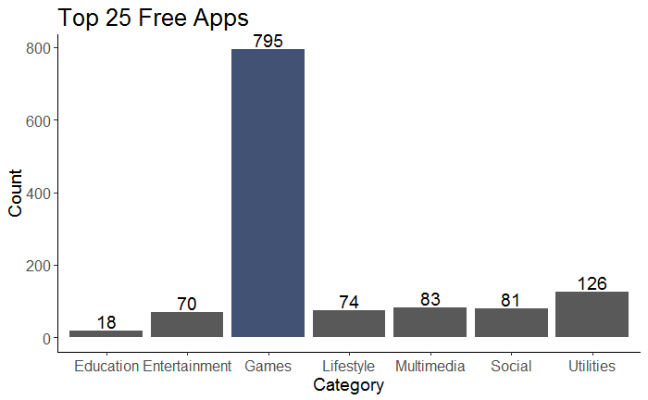
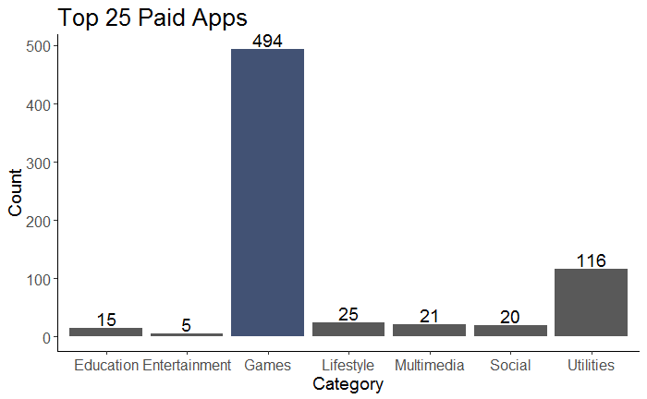
Games Dominate Top 25 Rankings
Gaming app has more potential for sustainable success
Notes:
Games appear more often in Top 25 than other categories
Top 25 eliminates disproportionate representation of games in market
Breaking assumption: free/paid same trend → not due to greater downloads due to free apps

Slide 6
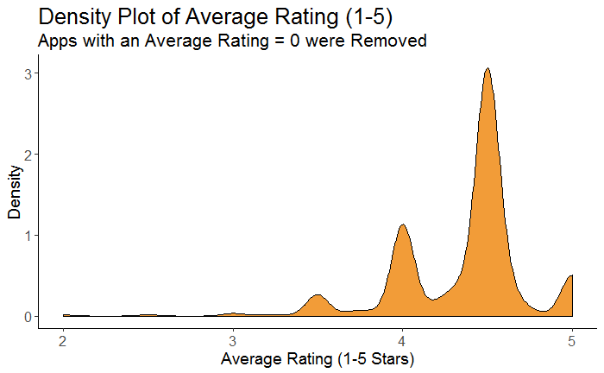
Higher Average Ratings Indicate Higher Positive Interactions with Games
Gaming app has more potential for sustainable success
Notes:
Higher Average Ratings for Games → positive interaction → want sustainable success → indicator of users liking the app

Slide 7
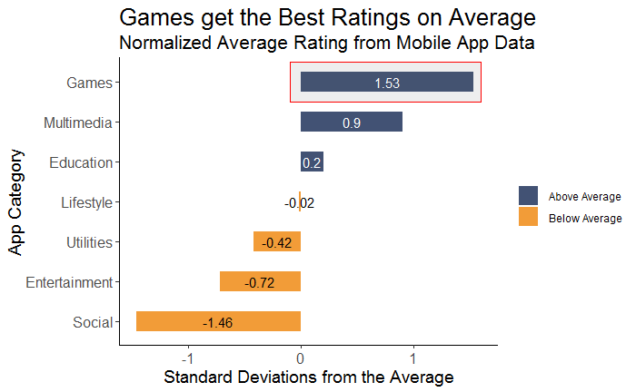
Higher Average Ratings Indicate Higher Positive Interactions with Games
Gaming app has more potential for sustainable success
Notes:
Higher Average Ratings for Games → positive interaction → want sustainable success → indicator of users liking the app

Slide 8
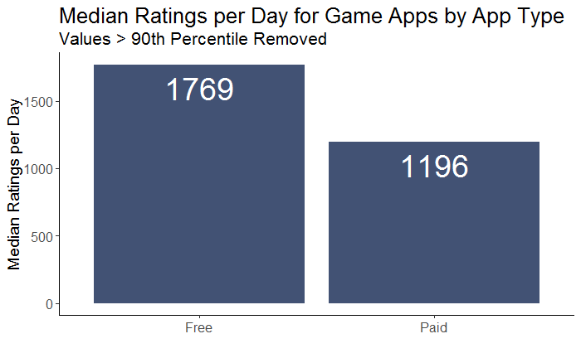

Free Apps Generate Greater Interactivity
Free apps generate stronger opinions from consumers which is more attractive to potential advertisers
Notes:
This shows people are downloading and using the app which makes it more valuable for advertisements

Slide 9
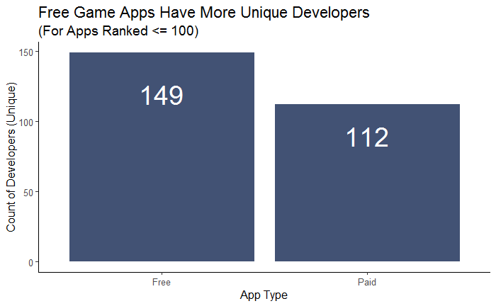
Free Apps Presents Greater Opportunity for New Developers
There are fewer barriers to entry for free apps owing to presence of more unique developers in the market
Notes:
Market is saturated in the Paid section

Slide 10
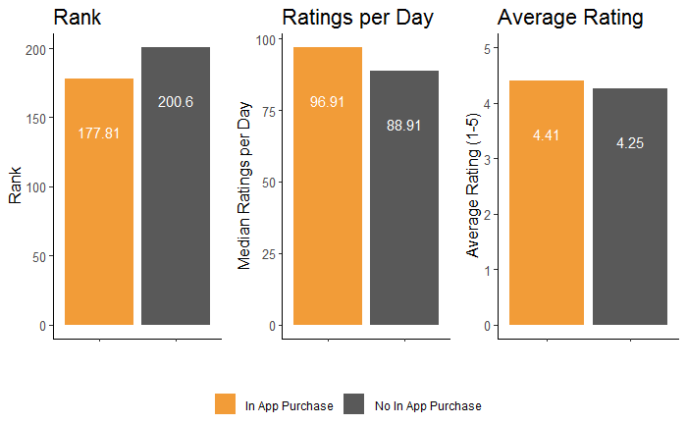
In-App Purchases Have a Positive Effect on Free Apps
Generate incremental revenue without impeding sustainable success
Notes:
In app purchases -> sustained success -> gets players to stay with app and stay connected with new content
And revenue

Slide 11
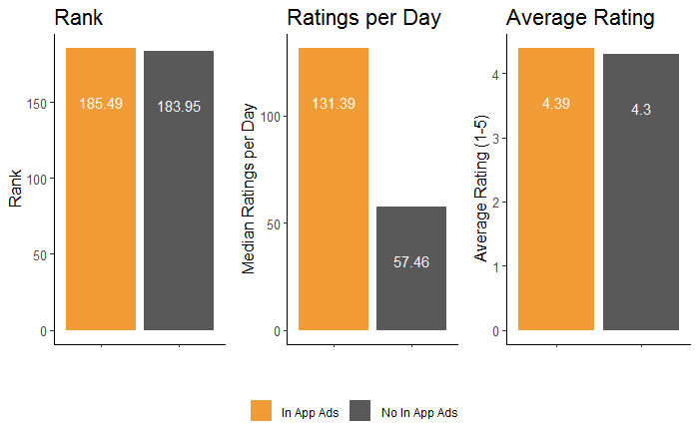
In-App Ads Do Not Have a Negative Effect on Free Apps
In-App-Ads generate incremental revenue with no detrimental effect on user experience

Slide 12
The Success of an App Requires Careful Entry to the Market
Characteristics
Distribution/Platform
Games
In-App Ads
USA
Google Play Store
Free
In-App Purchases
Mobile
Notes:
https://netwallcraft.com/maps-of-us-outline-blue-png-clipart-state-map/maps-of-us-outline-blue-png-clipart-state-map-save-maps-us-outline-blue-of-maps-of-us-outline-blue-png-clipart-state-map-new-maps-of-maps-of-us-outline-blue-png-clipart-state-map/
https://commons.wikimedia.org/wiki/File:China-outline.svg
https://www.vpndate.com/change-google-play-store-country-region-download-free-apps/
https://developer.apple.com

Slide 13
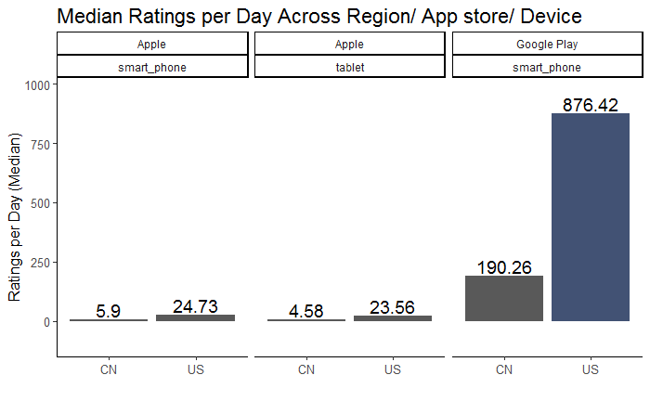
Mobile-US-Google Play Store Customers Interact with Apps More
Google Play and US is the best market for early success
Notes:
Chart got cut off
Device, app store, region - one slide

Slide 14
Successful Apps have Certain Attributes
Characteristics
Distribution/Platform
Games
In-App Ads
USA
Google Play Store
Free
In-App Purchases
Mobile
Notes:
To wrap up, our app should be a game because games are the most common app type among the top-25 rankings, and they have the highest positive reaction in terms of rating. Our app should be free game because free games are interacted with by users more than paid games, and they are easier to break into the market with. The app should also contain in-app ads and in-app purchases because neither measure hurts the app in terms of our success metrics, and ads provide revenue while purchases provide both revenue and reciprocated interaction by the developers to the users.
The app should be launched on a mobile device in the United States on the Google Play store because they each market is the most popular in terms of interaction amongst their respective competitors.
43

Slide 15
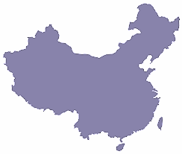

Expansion into China and the Apple App Store upon Sustained Success
USA
China
Google Play Store
App Store
Notes:
Implementing these characteristics will build a foundation for sustainable success and should this be the case, the next step would be expanding the availability of the app. Adapting it for release in China, and making it eligible for the Apple App store is where we recommend starting.

Slide 16
THANKS!
Notes:
Thanks for listening! Any questions?

